Slide 1
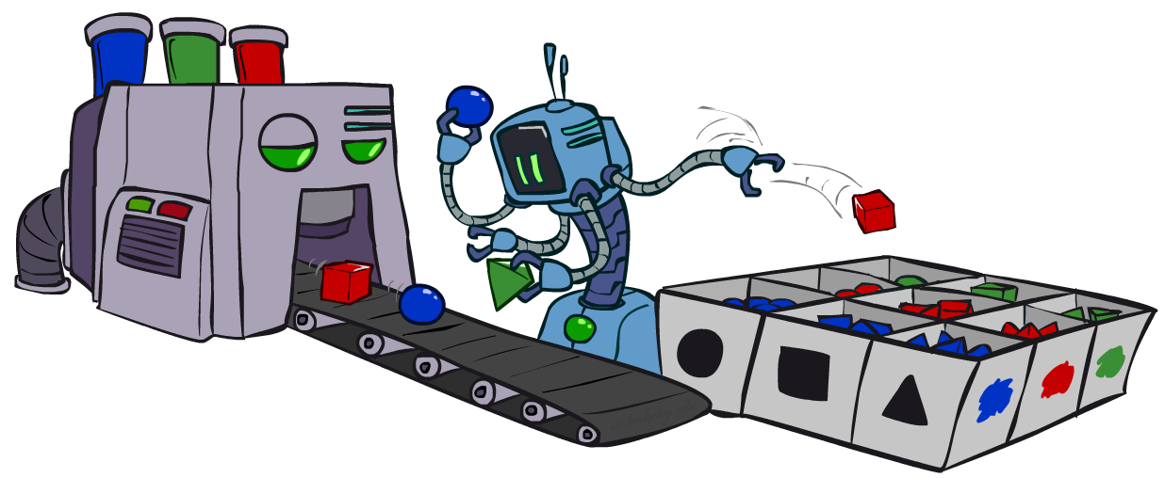
人工智能导论
贝叶斯网络: 近似推理Approximate Inference
Notes:
Please retain proper attribution, including the reference to ai.berkeley.edu. Thanks!

Slide 2
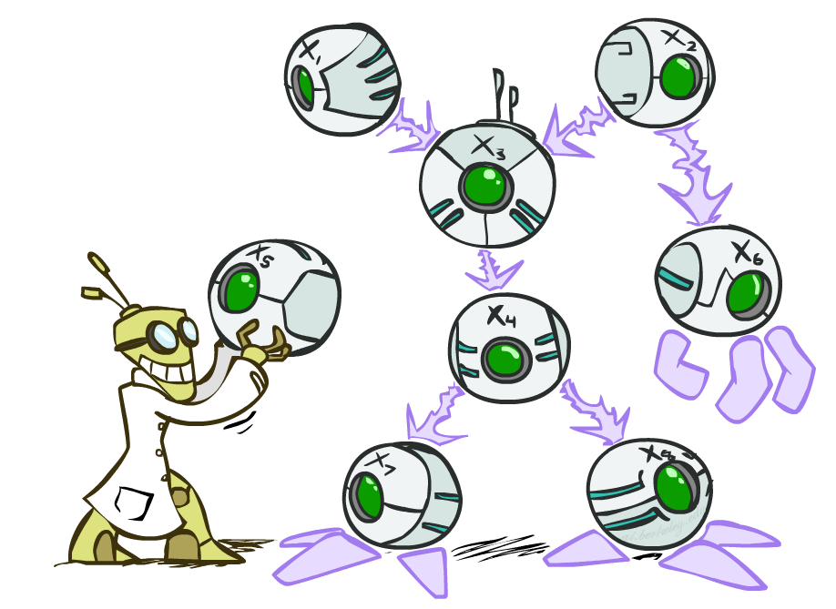

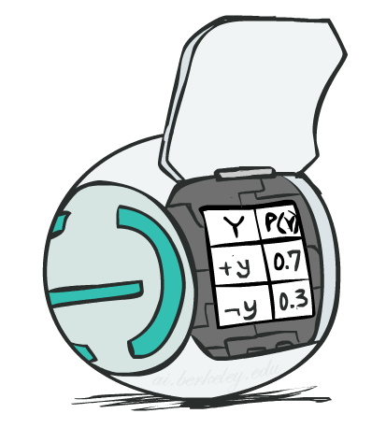
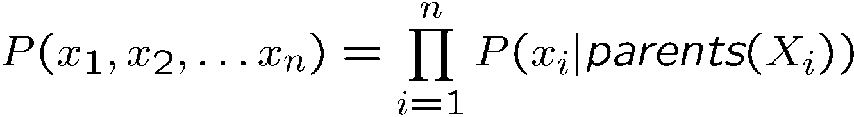
Bayes’ Net Representation
A directed, acyclic graph, one node per random variable
A conditional probability table (CPT) for each node
A collection of distributions over X, one for each combination of parents’ values
Bayes’ nets implicitly encode joint distributions
As a product of local conditional distributions
To see what probability a BN gives to a full assignment, multiply all the relevant conditionals together:
Notes:
Review

Slide 3
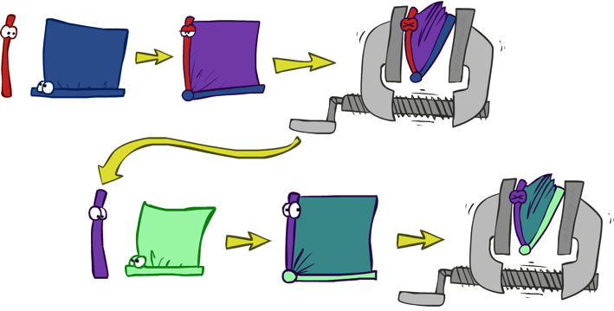









Variable Elimination
Interleave joining and marginalizing
d^{k} entries computed for a factor over k variables with domain sizes d
Ordering of elimination of hidden variables can affect size of factors generated
Worst case: running time exponential in the size of the Bayes’ net
…
…

Slide 4

近似推理：采样
Notes:
Can be done quickly, but if not running long enough, the result wouldn’t be accurate.

Slide 5

Sampling
Sampling is a lot like repeated simulation
Predicting the weather, basketball games, …
Basic idea
Draw N samples from a sampling distribution S
Compute an approximate posterior probability
Show this converges to the true probability P
Why sample?
Learning: get samples from a distribution you don’t know
Inference: getting a sample is faster than computing the right answer (e.g. with variable elimination)

Slide 6
采样（Sampling）
采样很像重复的模拟
基本思想
抽取 N 样本 ，形成一个采样分布 S
计算一个近似后验概率
证明可以收敛到真实的概率 P
为什么采样？
通常很快得到一个好的近似解
算法简单而且通用 (很容易应用在不同的概率模型上)
算法只需很少的存储空间 (O(n))
可以应用于大的模型上；对比准确算法（比如变量消除法）
Notes:
模拟一般是通过样本的均值来近似一个事件的概率。
Learning: get samples from a distribution you don’t know
Inference: getting a sample is faster than computing the right answer (e.g. with variable elimination)

Slide 7
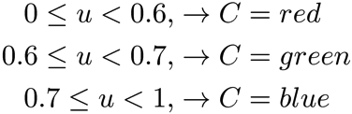

Sampling
Sampling from given distribution
Step 1: Get sample u from uniform distribution over [0, 1)
E.g. random() in python
Step 2: Convert this sample u into an outcome for the given distribution by having each target outcome associated with a sub-interval of [0,1) with sub-interval size equal to probability of the outcome
Example
If random() returns u = 0.83, then our sample is C = blue
E.g, after sampling 8 times:
C | P(C)
red | 0.6
green | 0.1
blue | 0.3

Slide 8
举例
假设你有两个大富翁游戏的智能体程序 A 和 B
A 获胜的概率是多少?
方法 1:
让 s 是一序列的骰子数，机会和公益金牌
给定 s, 结果 V(s) 可能是 1 （赢）, 0 （输）
A 赢的概率是 ∑_{s} P(s) V(s)
问题: 无限多这样的序列 s !
方法 2:
采样 N (也许 100) 组序列从概率分布 P(s) , 即玩 N 次游戏
A 获胜的概率大概是 (1/N) ∑_{i} V(s_{i}) 即在采样里获胜的比例

Slide 9
从一个离散分布中采样
步骤 1: 获取一个采样 u 从均匀分布 [0, 1)
例如 random()
步骤 2: 把这个采样值 u 转化成一个给定分布的输出结果。（通过关联每个输出结果 x 和一个 P(x)-大小的在[0,1) 上的一个子区间）
举例
如果 random() 返回 u = 0.83, 那么采样为 C = blue
再例如, 在8 次采样以后有:
C | P(C)
red | 0.6
green | 0.1
blue | 0.3
0.0 ≤ u < 0.6, → C=red
0.6 ≤ u < 0.7, → C=green
0.7 ≤ u < 1.0, → C=blue
Notes:
问题：如何验证这种采样方法的结果是和给定的随机变量的分布是吻合的？

Slide 10
贝叶斯网络里的采样
先验采样(Prior Sampling)
拒绝抽样(Rejection Sampling)
似然性/可能性加权(Likelihood Weighting)
吉布斯采样(Gibbs Sampling)

Slide 11
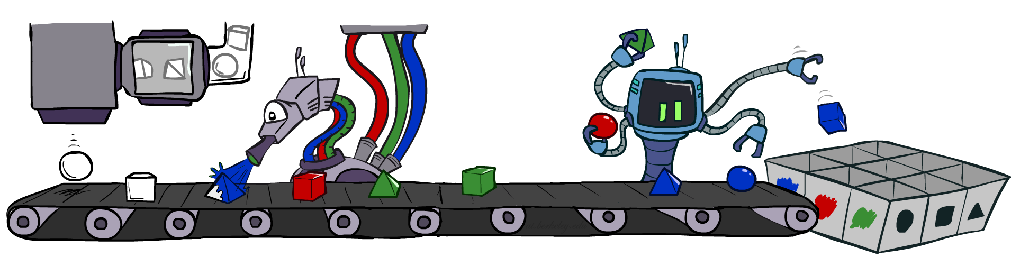
先验采样(Prior Sampling)

Slide 12
先验采样
For i=1, 2, …, n (按拓扑顺序)
采样 X_{i} 从 P(X_{i} | parents(X_{i}))
Return (x₁, x₂, …, x_{n})
Notes:
提问：问什么是拓扑排序？
Because you have to sample a variable before its all parents have been sampled.

Slide 13




先验采样
c | 0.5
¬c | 0.5
Cloudy
Cloudy
c | s | 0.1
 | ¬s | 0.9
¬c | s | 0.5
 | ¬s | 0.5
c | r | 0.8
 | ¬r | 0.2
¬c | r | 0.2
 | ¬r | 0.8
Sprinkler
Sprinkler
Rain
Rain
s | r | w | 0.99
 |  | ¬w | 0.01
 | ¬r | w | 0.90
 |  | ¬w | 0.10
¬s | r | w | 0.90
 |  | ¬w | 0.10
 | ¬r | w | 0.01
 |  | ¬w | 0.99
WetGrass
WetGrass
样本:
c, ¬s, r, w(这个例子里)
¬c, s, ¬r, w
…
Notes:
从父变量开始随机采样，按照其结果再随机采样子变量的值。
The probability distribution from which the value is sampled is conditioned on the values already assigned to the variable’s parents.
Samples were drawn from the joint distribution.
Question: what you can do with these samples?
It generated a specific event.

Slide 14
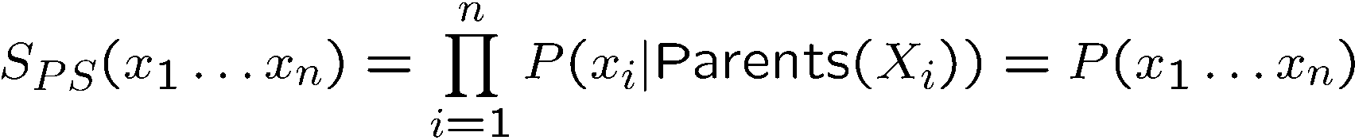

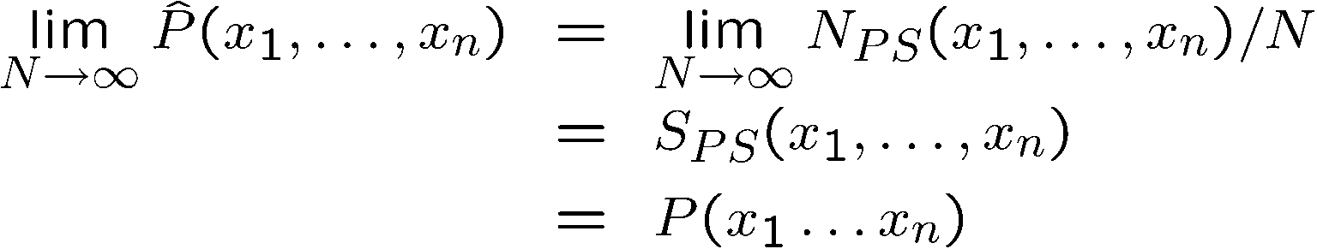
先验采样
这个过程产生这样的样本的概率是:
…即 是贝叶斯网络的联合概率
让 一个事件的样本数为
那么
即, 这个采样过程是 一致的/连续的(consistent)
Notes:
Just looking at the sampling process, we have the first formula above, because each sampling step depends only on the parent values.
『那么』后面的推导是根据统计的大数定理。
S_ps means sample distribution of (the sample) by the prior sampling method.

Slide 15
Prior Sampling
This process generates samples with probability:
…i.e. the BN’s joint probability
Let the number of samples of an event be
Then
I.e., the sampling procedure is consistent

Slide 16
例如
我们从这个贝叶斯网络里获得一系列的样本:
c, ¬s, r, w
c, s, r, w
¬c, s, r, ¬w
c, ¬s, r, w
¬c, ¬s, ¬r, w
如果我们想知道： P(W)
我们可以数出 <w:4, ¬w:1>
正规化后得到 P(W) = <w:0.8, ¬w:0.2>
样本越多，越接近真实的分布
还可以估计其他的概率量
比如, 想查询概率 P(C| r, w)， 使用 P(C| r, w) = α P(C, r, w)
C
S
R
W
Notes:
这里是通过样本来计算一个边缘概率分布P(W
P(C | -r, -w)? – think about its drawback.

Slide 17
Example
We’ll get a bunch of samples from the BN:
+c, -s, +r, +w
+c, +s, +r, +w
-c, +s, +r, -w
+c, -s, +r, +w
-c, -s, -r, +w
If we want to know P(W)
We have counts <+w:4, -w:1>
Normalize to get P(W) = <+w:0.8, -w:0.2>
This will get closer to the true distribution with more samples
Can estimate anything else, too
What about P(C | +w)? P(C | +r, +w)? P(C | -r, -w)?
Fast: can use fewer samples if less time (what’s the drawback?)
C
S
R
W

Slide 18
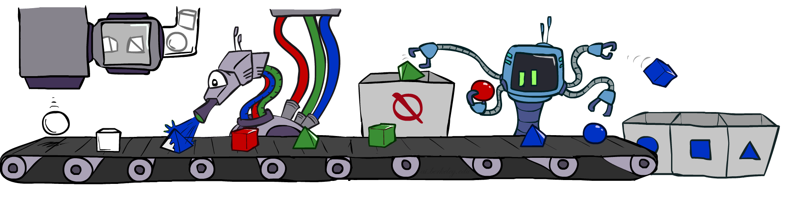
拒绝采样(Rejection Sampling)

Slide 19
拒绝采样Rejection Sampling
输入: 观察值 e₁,..,e_{k}
For i=1, 2, …, n
采样 X_{i} 从 P(X_{i} | parents(X_{i}))
如果 x_{i} 和观察值不一致
拒绝这个样本: Return, 则在这个循环里没有样本产生
Return (x₁, x₂, …, x_{n})
Notes:
Its benefit is that it can break the inner cycles of generating useless samples.
But it may also throw out a lots of evidenced samples.
In the picture, it tries to compute P(shape| blue), so it throwed different colors of shapes.

Slide 20
拒绝采样
为了计算条件概率，对先验采样进行简单修改
假如我们想计算 P(C| r, w)
计算采样中 C 的结果, 但是忽略（拒绝） 那些不含有 R=true, W=true的样本
这就叫做拒绝采样
对于条件概率的估计，也是满足一致性的 (即, N趋于无限大时，等于理论真值)
C
S
R
W
c, ¬s, r, w
c, s, ¬r
¬c, s, r, ¬w
c, -s, ¬r
¬c, ¬s, r, w
Notes:
The problem is that it rejects so many samples. It may take a long time to take samples, as the fraction of samples consistent with the evidence e drops exponentially as the number of evidence variables grows. So the procedure is simply unusable for complex problems.

Slide 21
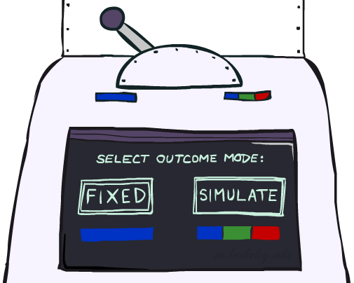
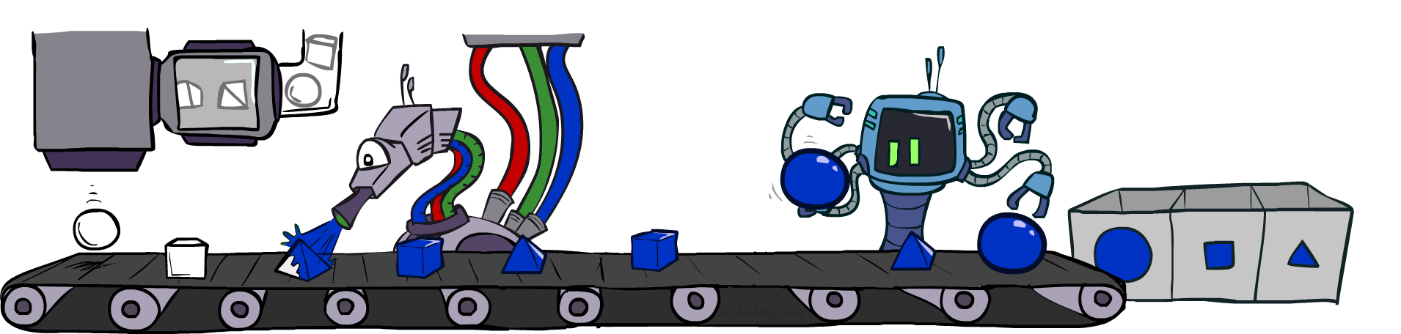
似然性加权（采样） Likelihood Weighting

Slide 22
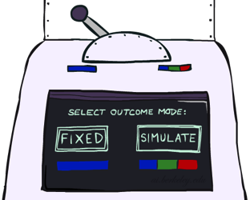


似然性加权（采样）
拒绝采样法的问题:
有可能拒绝许多样本，尤其当观察变量很多时
采样时没有利用已被观察变量的值
比如考虑 P(Shape|Color=blue)
想法: 固定观察变量的值，对其他变量值进行采样
问题: 样本分布与理论分布不一致!
解决办法: 权重 每个样本，通过使用观察变量给定父变量的概率
pyramid, green
pyramid, red
sphere, blue
cube, red
sphere, green
Shape
Color
Shape
Color
pyramid, blue
pyramid, blue
sphere, blue
cube, blue
sphere, blue
Notes:
It fixes the values for evidence variables and samples only the non-evidence variables. (This will break the prior distribution, how to fix it.)
And each sampled event is weighed by the likelihood that event accords to the evidence, as measured by the product of the conditional probabilities for each evidence variable, given its parents.
It utilizes every sample.

Slide 23
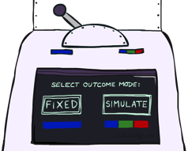
似然性加权采样
输入: 观察值 e₁,..,e_{k}
w = 1.0
for i=1, 2, …, n
如果 X_{i} 是已观察的变量（evidence variables）
x_{i} = 观察到的 value_{i} for X_{i}
让 w = w * P(x_{i} | Parents(X_{i}))
否则
抽样 x_{i} 从 P(X_{i} | Parents(X_{i}))
return (x₁, x₂, …, x_{n}), w
Notes:
It could be such case that weights on evidences are generally very small.

Slide 24



似然性加权（采样）
w 初始化为1.0；
拓扑排序：C, S, R,W
S, W 值固定为真
c | 0.5
¬c | 0.5
Cloudy
Cloudy
c | s | 0.1
 | ¬s | 0.9
¬c | s | 0.5
 | ¬s | 0.5
c | r | 0.8
 | ¬r | 0.2
¬c | r | 0.2
 | ¬r | 0.8
Sprinkler
Sprinkler
Rain
Rain
s | r | w | 0.99
 |  | ¬w | 0.01
 | ¬r | w | 0.90
 |  | ¬w | 0.10
¬s | r | w | 0.90
 |  | ¬w | 0.10
 | ¬r | w | 0.01
 |  | ¬w | 0.99
WetGrass
样本事件:
WetGrass
c, s, r, w
…
该样本事件的权值:
Notes:
计算该采样的样本的发生概率。每次遇到一个固定的观察值时，该样本权重乘以相应的条件概率。
0.1从S的条件概率得到；0.99从W的条件概率得到。First samples Cloudy, then Rain.

Slide 25
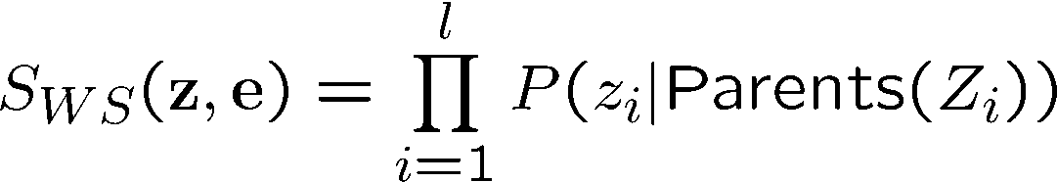
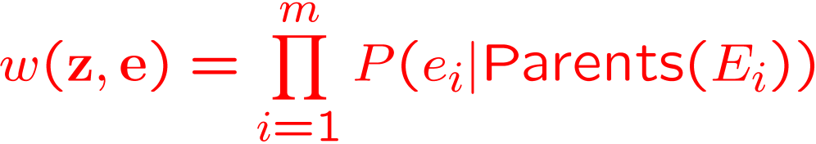
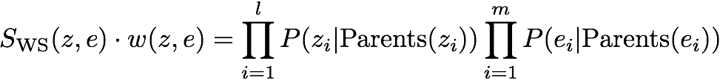

似然性加权采样
采样分布为（ z 为非观察变量的采样值 e 为固定的观察值）
现在, 每个样本都有权重
合起来, 加权的样本分布是具有一致性的，即：
Cloudy
C
S
R
W
Notes:
Z: nonevidence variables. The algorithm samples each variable in Z given its parent values.
The weight for a given sample, is the product of the likelihoods（product of conditional probabilities） for each evidence variable given its parents.
Multiplying these two together covers all the variables in the network. Hence likelihood weighting returns consistent estimates.
l+m=变量的总数。

Slide 26
似然性加权
优点：
可利用所有样本（加权的）
下游 变量的采样值会被 上游 已观察变量的值所影响 (当观察变量处在网络上游的时候)
也有弱点：
上游 变量 的采样值 不受 下游 观察变量值的影响
假设观察到的值在 k 个叶节点上, 那么样本的权重可能为 O(2^{-k})
随着观察变量的增多，而且如果这些变量出现在拓扑顺序的后面，那么许多样本的权值会很小，只有极少的幸运样本将有相对很大的权值，从而主导估计概率的结果
我们希望的是，每个变量都可以“看见”所有 已观察到的值 !
Notes:
It’s good for evidence happed earlier up on networks, because in that way more of our samples will reflect the state of the world suggested by the evidence
弱点是：如果观察值都出现在下游（即 子节点上），那么上游的随机变量当进行随机采样时不能反映当前（观察到的情况），这暗示着其对应的似然权值有可能会很小。这样的样本价值则很小。
If the evidence variables occur late, then non-evidence variables will have no evidence in their parents to guide samples generation.
This means the samples will be simulations that bear little resemblance to the reality suggested by the evidence.

Slide 27
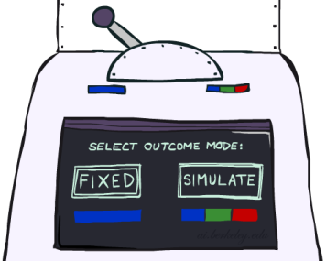
Likelihood Weighting
Likelihood weighting is good
We have taken evidence into account as we generate the sample
E.g. here, W’s value will get picked based on the evidence values of S, R
More of our samples will reflect the state of the world suggested by the evidence
Likelihood weighting doesn’t solve all our problems
Evidence influences the choice of downstream variables, but not upstream ones (C isn’t more likely to get a value matching the evidence)
We would like to consider evidence when we sample every variable (leads to Gibbs sampling)
C
S
R
W

Slide 28
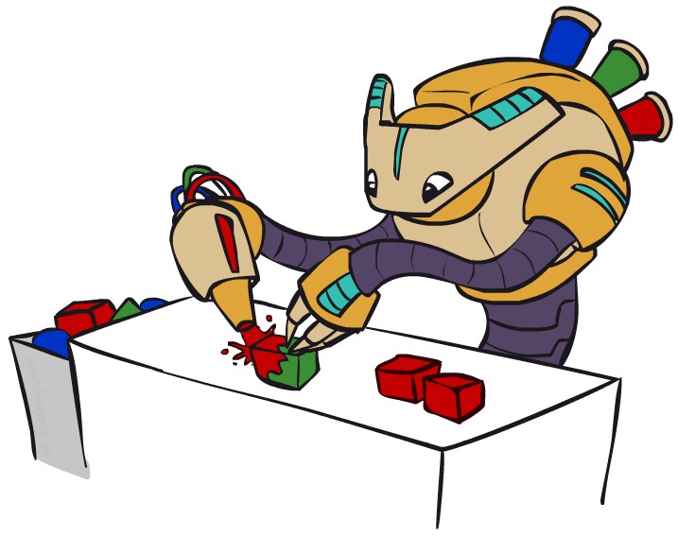
吉布斯采样(Gibbs Sampling)

Slide 29
吉布斯采样 （Gibbs sampling）
属于 MCMC 家族一类
状态是对所有变量的完整的赋值
(对比局部搜索里的 模拟退火算法，属于同一算法家族!)
观察（证据）变量的值固定，改变其他变量的值
当产生下一个状态时, 选出一个变量，并对其采样一个值，采样的分布是条件于所有其他变量
X_{i}’ ~ P(X_{i} | x₁,..,x_{i-1},x_{i+1},..,x_{n})
趋向于朝高概率发生的状态移动，但也可能移动到一个低概率的状态
在贝叶斯网络里, P(X_{i} | x₁,..,x_{i-1},x_{i+1},..,x_{n}) = P(X_{i} | 马可夫毯(X_{i}))
定理: 吉布斯采样是具有一致性的
如果假定吉布斯分布概率是远离0和1，并且变量选择是公平的

Slide 30
Gibbs Sampling吉布斯采样
Procedure: keep track of a full instantiation x₁, x₂, …, x_{n}. 固定观察变量的值，给其他变量进行随机赋值。 每次选择一个未观察变量，并对它进行采样给定所有其他变量的赋值, 但是保持观察变量的值固定. 重复这一过程很长时间.
Property: in the limit of repeating this infinitely many times 结果的样本将与条件于观察值的分布相一致.
Rationale: 对上游和下游的变量的采样都将基于观察值.
In contrast: likelihood weighting only conditions on upstream evidence, and hence weights obtained in likelihood weighting can sometimes be very small. Sum of weights over all samples is indicative of how many “effective” samples were obtained, so we want high weight.

Slide 31
Gibbs Sampling Example: P( S | +r)
Step 1: Fix evidence
R = +r
Steps 3: Repeat
Choose a non-evidence variable X
Resample X from P( X | all other variables)
Step 2: Initialize other variables
Randomly
C
C
S
+r
S
+r
W
W
C
C
C
C
C
C
S
+r
S
+r
S
+r
S
+r
S
+r
S
+r
W
W
W
W
W
W

Slide 32
吉布斯采样举例: P( S | r)
Step 1: 固定观察值
R = true
Step 3: 重复以下
选择一个非证据变量 X
重采样 X 从 P(X | 马可夫毯(X))
Step 2: 初始化其他变量
随机地
C
C
S
r
S
r
W
W
C
C
C
C
C
C
S
r
S
r
S
r
S
r
S
r
S
r
W
W
W
W
W
W
采样 S ~ P(S | c, r, ¬w)
采样 C ~ P(C | s, r)
采样 W ~ P(W | s, r)
Notes:
马可夫毯包括一个变量节点的父节点，子节点和子节点的父节点。
可能需要计算条件概率分布后才能从中采样。

Slide 33
为什么这样做？
采样很快开始反应网络里所有的观察值（已观察节点的值对其他变量值的采样施加影响）
最终样本将从真实的后验概率分布上抽取!

Slide 34
Gibbs Sampling
How is this better than sampling from the full joint?
In a Bayes’ Net, sampling a variable given all the other variables (e.g. P(R|S,C,W)) is usually much easier than sampling from the full joint distribution
Only requires a join on the variable to be sampled (in this case, a join on R)
The resulting factor only depends on the variable’s parents, its children, and its children’s parents (this is often referred to as its Markov blanket)

Slide 35
如何进行采样？
重复以下多次：
对一个非观察到的变量 X_{i} 进行采样，从概率分布：
P(X_{i} | x₁,..,x_{i-1},x_{i+1},..,x_{n}) = P(X_{i} | 马尔科夫毯(X_{i}))
= α P(X_{i} | u₁,..,u_{m}) ∏_{j} P(y_{j} | parents(Y_{j}))
Notes:
Us are parents of X, Ys are children of X.

Slide 36
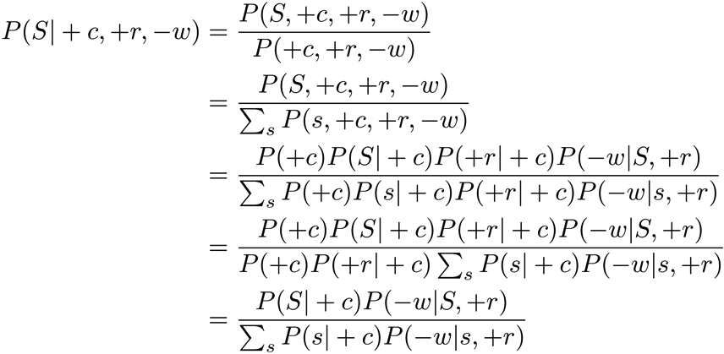
Efficient Resampling of One Variable
Sample from P(S | +c, +r, -w)
Many things cancel out – only CPTs with S remain!
More generally: only CPTs that have resampled variable need to be considered, and joined together
C
S
+r
W

Slide 37

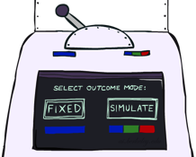

贝叶斯网络采样技术小结
先验采样 P
似然加权采样法 P( Q | e)
拒绝采样法 P( Q | e )
吉布斯采样 P( Q | e )

Slide 38
马尔科夫蒙特卡洛 (Markov Chain Monte Carlo)
MCMC (Markov chain Monte Carlo) 是随机算法家族一员，用来估计在一个很大的状态空间里某个感兴趣的数值
Markov chain = 一序列随机选择的状态 (“随机漫步random walk”), 其中每个状态的选择是基于它前一个状态
Monte Carlo = 摩纳哥的旅游城市，有一个著名的赌场

Slide 39
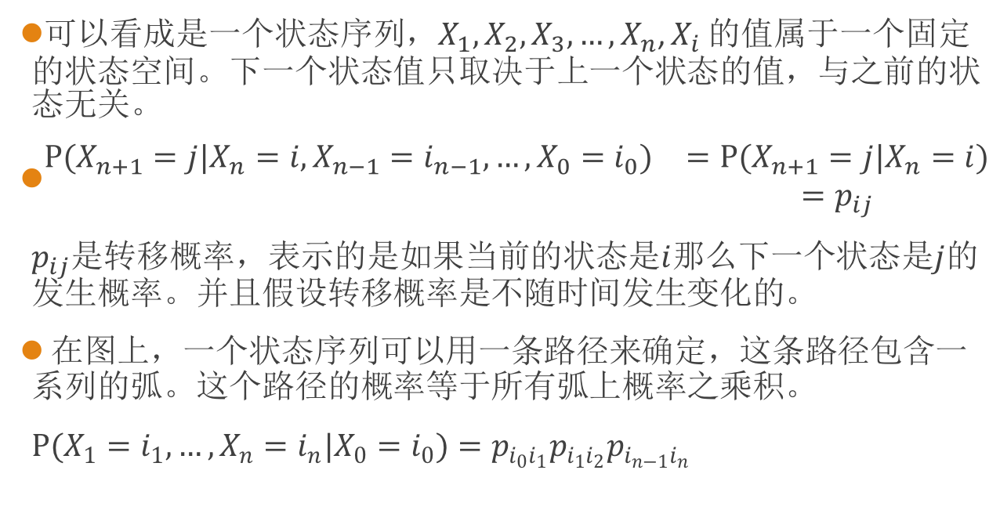
马科夫链(Markov Chain)
可以看成是一个状态序列，$X_{1},X_{2},X_{3},…,X_{n}$, $X_{i}$ 的值属于一个固定的状态空间。下一个状态值只取决于上一个状态的值，与之前的状态无关。
$\begin{matrix}P(X_{n+1}=j|X_{n}=i,X_{n−1}=i_{n−1},…,X_{0}=i_{0}) & =P(X_{n+1}=j|X_{n}=i) \\ & =p_{ij}\end{matrix}$
$p_{ij}$是转移概率，表示的是如果当前的状态是$i$那么下一个状态是$j$的发生概率。并且假设转移概率是不随时间发生变化的。
在图上，一个状态序列可以用一条路径来确定，这条路径包含一系列的弧。这个路径的概率等于所有弧上概率之乘积。
$P(X_{1}=i_{1},…,X_{n}=i_{n}|X_{0}=i_{0})=p_{i_{0}i_{1}}p_{i_{1}i_{2}}p_{i_{n−1}i_{n}}$
Notes:
链式贝叶斯网络。

Slide 40
举例：每周上人工智能课的学习状态
0.2
0.8
1
2
0.4
跟上课堂学习
0.6
落后于课堂学习
问题：假定开学第一周跟上了课堂学习，那么在接下来的第二、三周里落后于课堂学习，并在第四周里又跟上课堂学习的概率是多少？
Notes:
0.048.

Slide 41
马尔科夫蒙特卡洛 理论 Markov Chain Monte Carlo
MCMC 属于随机算法家族，用于在一个很大的状态空间里，近似估计某些感兴趣的量
马尔科夫链 = 一序列随机选择的状态 (“随机漫步random walk”), 每个状态的选择是条件取决于前一个状态
蒙特卡洛理论 Monte Carlo = 一种算法 (通常基于随机采样) ，存在产生一个不正确解答的可能性（概率）
MCMC = 随机漫步一会，平均化你所观察到的情况
Notes:
MCMC is a technique for sampling a multivariate probability distribution. It can be used to estimate the expected value of a function f(x), x assumed to be a high dimensional vector variable, with an exponentially growing value space.
E(f) = Sum_x f(x)p(x).
Directly calculating this value may require exponential time.(complexity of the value space). Instead, averaging f over samples provides an estimate of the sum.

Slide 42
为什么这种方法有效?
假定运行这种方法很长一段时间，并预测在时刻 t 到达任何一个状态的概率为： π_{t}(x₁,...,x_{n}) or π_{t}(x)
对每个吉布斯采样步骤 (挑一个变量, 重采样它的值) 当它应用到一个状态 x 时，有一个概率 q(x’ | x) 移动到下个状态 x’
所以 π_{t+1}(x’) = ∑_{x} q(x’ | x) π_{t}(x) 或, 用矩阵或向量形式表示： π_{t+1} = Qπ_{t}
当这一动态过程处于平衡，即 π_{t+1} = π_{t} ，所以 Qπ_{t} = π_{t}
这种情况下有一个唯一解，即 π_{t} = P(x₁,...,x_{n} | e₁,...,e_{k})
所以当时刻 t 足够大时，下一个样本将会从真实的后验条件概率分布上被采集
Notes:
解释这种方法的一致性。所谓一致性即指『下一个样本将会从真实的后验条件概率分布上被采集』。

Slide 43
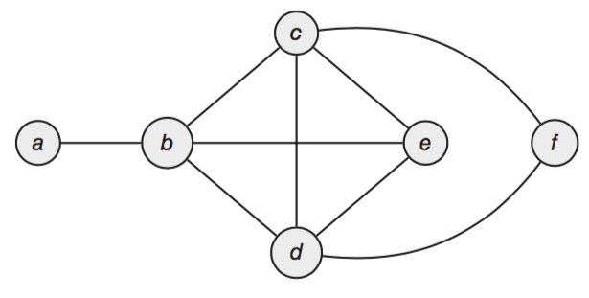
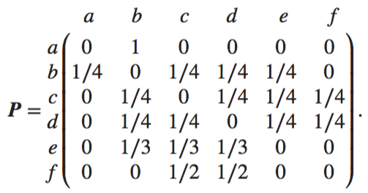
随机漫步（随机游走）(Random Walk)
Notes:
Let Xn be the frog’s location after n hops. The sequence X0,X1,... is a Markov chain. Uniformly hop according to vertex degrees.
Of particular interest is the long-term behavior of the random walk. What can be said of the frog’s position after it has been hopping for a long time?

Slide 44
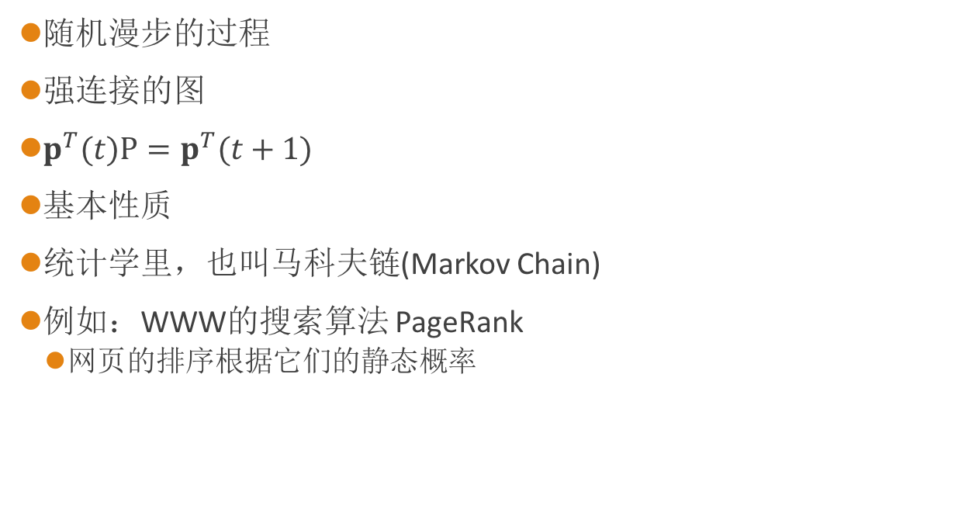
随机漫步（随机游走）(Random Walk)
随机漫步的过程
强连接的图
$p^{T}(t)P=p^{T}(t+1)$
基本性质
统计学里，也叫马科夫链(Markov Chain)
例如：WWW的搜索算法 PageRank
网页的排序根据它们的静态概率
Notes:
refers to my note of random walk.
问题：如何计算静态概率分布？（求解线性方程组）

Slide 45
Further Reading on Gibbs Sampling*
Gibbs sampling produces sample from the query distribution P( Q | e ) in limit of re-sampling infinitely often
Gibbs sampling is a special case of more general methods called Markov chain Monte Carlo (MCMC) methods
Metropolis-Hastings is one of the more famous MCMC methods (in fact, Gibbs sampling is a special case of Metropolis-Hastings)
You may read about Monte Carlo methods – they’re just sampling

Slide 46
Markov Chain Monte Carlo*
Idea: instead of sampling from scratch, create samples that are each like the last one.
Procedure: resample one variable at a time, conditioned on all the rest, but keep evidence fixed. E.g., for P(b|c):
Properties: Now samples are not independent (in fact they’re nearly identical), but sample averages are still consistent estimators!
What’s the point: both upstream and downstream variables condition on evidence.
+b
+a
+c
-b
+a
+c
-b
-a
+c

